Slide 1
AD-1380: A Beard, An App, A Blender
Eric McCormick

Slide 2
Who?

Slide 3
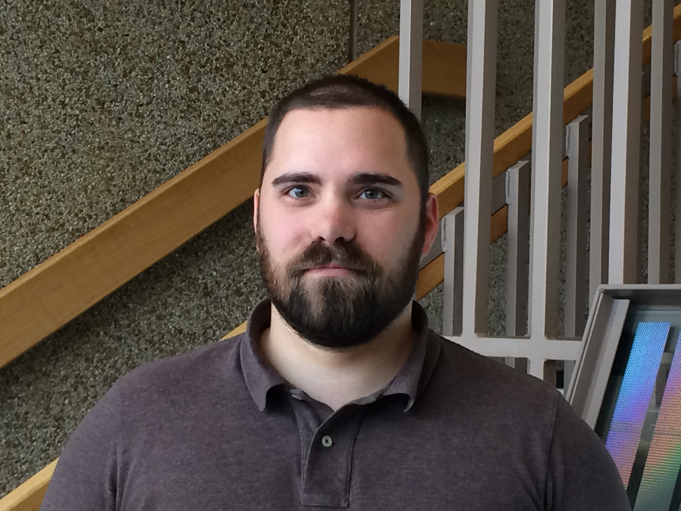
Who is talking?
Eric McCormick
developer
husband
father
veteran
former EMT
blogger
…more than I have space for
edm00se.io
@edm00se

Slide 4

Who, continued
Web Developer at
a fourth-generation, family-owned professional construction services firm, in operation since 1889
my focus usually revolves around:
document control
productivity and performance metrics
system integration
process automation

Slide 5
Who's This Session For, and Why?
Developers, who have a passion for
application structure, standards, and maintenance
documentation
testing
automation
Non-Developers (development-adjacent roles)
who want a developer's take on the above

Slide 6
What's the Session?

Slide 7
AD-1380: A Beard, An App, A Blender…
…one developer’s take on building applications with Domino/XPages
should probably be …one developer’s take on expanding how we can build applications with Domino/XPages

Slide 8
Session Abstract
Building applications with Domino/XPages opens a number of doors. Choosing the right path is what becomes hard. This is a session on one developer's take on the way we can structure our applications to get the best of the Domino/XPages platform in addition to all the modern, front-end tooling that the rest of the industry is using to great advantage. This session will cover an approach to app dev via application segregation mechanics, providing the data via HttpServlets to provide a RESTful JSON API, and a UI-layer that automates the majority of concerns via a JS MV* framework. Front-end tooling via Yeoman, Grunt, and Bower (and/or others) can aid in our development and testing, back-end mocks for making contracted work easier, and other techniques.

Slide 9
Ms. America Statement
A harmonious development environment for myself and any development staff at my company
A unified theory practice of development, for consistent cross-platform and cross-app development behavior
Making all application logic and data consistently accessible across separate, but organic, systems
Making contracted development work more easily performed
Automating everything I can

Slide 10



Alternative Session Title
Eric McCormick and the Quest to Develop Amazing Applications

Slide 11
My Personal Goals (a.k.a.- my ‘quest’)
Use the best tools available to aid my development workflow
Automate all tasks I can, for consistency, ease, and speed
Enforce coding, documentation, and testing standards at each level of the application
All of which feeds into my ultimate goal of developing the best apps I can, by enabling the developer (that's me!)

Slide 12

I Want It All

Slide 13
Session Overview

Slide 14
Session Content
Application Structure
Segregated back- and front-ends
Services layering concepts (by nature and convention)
Back-End
Beans, Controllers, and M-V-C advantages
RESTful API benefits, via HTTPServlets
Front-End
M-V-* and JS frameworks
Advanced tooling for better/faster/stronger development

Slide 15
Concerning Application Structure

Slide 16
Application Structure?
Segregation of Application Into Service Layers
a decoupling of the layers of your application into micro-services*
separates the primary application logic into its own classes
keeps the UI logic all at the UI level
keeps styling and presentation out of the logic
keep all your code readable by not just yourself, but others

Slide 17
Application Structure? (pt.2)
Application Layers (as I see them)
data store / DB (NSF)
primary application classes (server elements for data objects, controllers for behavior, server actions)
expose application via servlets (RESTful or otherwise), XPages bindings (EL to bean, or data object)
provides interface to UI layer (where the client-side logic lives)

Slide 18
Application Structure? (pt.3)
we’re already starting to talk in terms of what we will require for an application’s
data
primary business logic (which wrapped with the database creates the data service)
creating an API, for how a user or front-end can interface with our service
all of this makes our choice of front-end, be it an XPages app with managed bean or object data source (xe:objectData) or a non-XPages front-end immaterial far less consequential

Slide 19
Advantages and Disadvantages
Advantages
consistency in an app and across apps
normalizing of development patterns
easier to:
support/maintain
document
test
Disadvantages
time
thought
willingness to attempt
management sign-off
Notes:
The advantages sell themselves.
As for disadvantages, if anyone believes it’s more time consuming to approach a proper layout to an application when it’s being initially constructed or in its infancy, there is virtually no cost. Converting takes time, so lay your foundation well.
I used to think that my management would have some difficulty accepting my thoughts and approaches on the higher level side of my application development efforts, but when it came down to it, after running into multiple issues over multiple years with our largest app (which I maintain and continue development on in a few areas), I’ve found that the more I do talk with my management about the larger issues, the more they assume I have any tedium handled. This has taken a few years but has paid dividends; especially when it comes to building trust with my management after several creative solutions following the POODLE + other HTTPS/SSL debacles over the last year or so.
In other words, when your management take you seriously when you prefix a thought with “Eric’s crazy talk”, you’ve reached a level of trust; trust cultivated from time and effort spent not just on creating widget X, but also understanding the ramifications of that widget, it’s interactions, and how it will work in a deployed, at scale capacity.

Slide 20
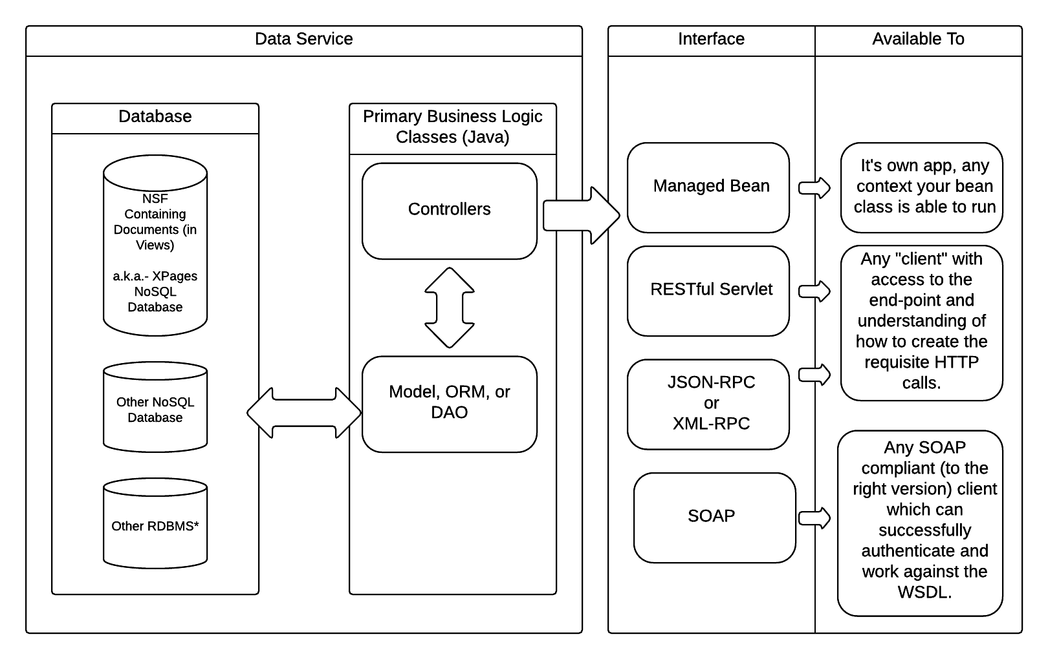
High Level Overview
Notes:
Focusing on application structure and the flow of data (which is how my head works). There are great other angles to look at an application before/during/after during continuing development, such as user interactions (how many clicks, ease of access), but when it comes to interfacing with data, which is usually my biggest concern, this is what makes sense to me.

Slide 21
Service Layers
keeps:
data
logic
client interface
all nice and tidy, this benefits in the forms of:
organization
maintenance
documentation (let’s face it, a JavaDoc is better than no doc)

Slide 22
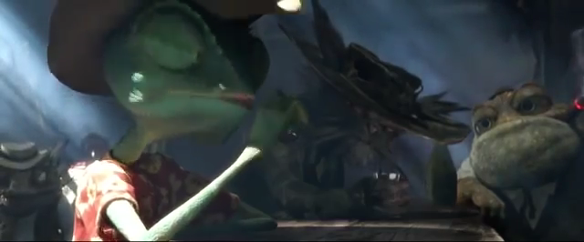
Stay With Me Now
Notes:
Rango may be in a whole heap of trouble for all his tall tales, but “stay with me now”.

Slide 23
Application Structure Related References
Jesse Gallagher blog: https://frostillic.us
Dec’s Dom Blog blog: http://www.qtzar.com/
Pipalia blog: http://www.pipalia.co.uk/blog/
John Daalsgard blog: https://www.dalsgaard-data.eu/blog/
Paul S. Withers http://www.intec.co.uk/blog/
Amongst many others.
Notes:
I’m not the only one talking about app structure. In fact, this is probably one of the most common 2nd or 3rd order themes amongst developers since applications began being developed. Here are some references which have been great additions for the cause in the Domino / XPages world.

Slide 24
Concerning the App’s Back-End

Slide 25
SSJS and Java
SSJS
was meant to help bring in gun shy developers
com.ibm.jscript isn’t SSJS like other (more popular) SSJS implementations
DDE often misses complex context assistance as JS is not a strongly type’d language
Java
is a strong type’d language
“no” (normal API induced) runtime exceptions
is (more) extensible
more industry norm
(DD)Eclipse “does Java well”
Notes:
Domino/XPages SSJS is a weird beast, only supports up through ECMAScript 4, and while you can specify a variable’s type (using colon notation), it’s not the norm for most people. Also, if you’re going to specify type for each variable, what’s the big complaint about Java?
“No runtime exceptions” = shouldn’t be likely, if ever. If only we could deal with a native API that doesn’t throw NotesExceptions for about everything.
Eclipse “does java well” in the sense that the content assistance and overall Java editor experience is an excellent standard.

Slide 26
A Horrific Pitfall
Spaghetti Code™
un-supportable applications that have logic strewn about through design/markup (where is the code that’s breaking?)
overly large SSJS script libraries that add runtime parse bloat
a lack of concise organization which any larger app needs
SSJS is a crutch (at least for non-trivial / non-RAD applications)
It works, but the overarching answer is to use the Java of XPages for better performance, structure, and sanity.
Notes:
Some have avoided Java in XPages because Java is “scary”. While some may seem daunted, it’s not that hard for a developer to pick up, has been around long enough to be a mature language, performs

Slide 27
Making Sense of the Back-End pt.1
Data as a resource…
how should the data:
validate
at the db / data object level
at the ui level
integrate
methods of exposure (collections, records, actions)
with other systems
Notes:
As my data service diagram depicts, there are options. Finding the needs of an application, connections and integrations with other systems and points of entry, so to speak, can help drive our direction.

Slide 28
Making Sense of the Back-End pt.2
Use the best tools at your disposal!
OpenNTF Domino API
Git (or Mercurial)
Swiper (to eliminate extraneous output to ODP)
Apache Commons libraries (e.g.- CollectionUtils, validators)
Google GSON
Barista (for bean fans)
Jesse’s Controllers (or whole frostillicus framework)
Notes:
Note: some of these require a change in the java.pol(icy) file for security permissions.
Non-obvious things:
GSON lets you reflect data from JSON to a proper Java Object (by its class definition) in addition to a convenient toJson method; it sure beats the snot out of typing out the lines for creating a new object, create new property (by type), then setting the value, etc.
Swiper eliminates a lot of the “bloat” of syncing with an On Disk Project (ODP) and is what allowed me to take our largest app to its first, prototype stage of build automation using headless DDE (was previously generating too many conflicting design elements, making the app non-usable OoB).

Slide 29
Java Policy
*Certain Java libraries won’t run from an NSF container (versus OSGi plug-in) without the java.pol(icy) having additional permissions being granted.
Setting the grant block for all permission can sound “scary”, but really only means that you’re trusting your NSF contained Java code to not bork your server via the class loader involved.

Slide 30
Back-End Components Demo (#1)

Slide 31
Concerning the App’s Front-End

Slide 32

Fasten Your Seatbelt

Slide 33
M-V-* and JS Frameworks
an explosion of frameworks and libraries that can help make our development easier
frameworks adopting MVC, MVM, MVVM, MV* approaches to automate the data bindings and logic
a veritable potpourri of options and many developers have quite different takes on which framework to use and why
this can be highly opinionated, even heated
Notes:
What I chose and why, along with other options.

Slide 34
Advanced Tooling
dependency management for the front-end
scaffolding repeatable parts of development
task runners to provision:
distributable / deployment builds
complete with minification/uglification
automatic reload during development
unit / e2e testing
publishing documentation

Slide 35
In other words…
If you can, automate it!

Slide 36
Front-End Components Demo (#2)

Slide 37
Opportunity Demo (#3)

Slide 38
Opportunity Demo (#4)

Slide 39
Q&A

Slide 40
Summary
we’ve covered the components of application structure options and practices to build better applications through segregated service layers
…practices and techniques to automate and expedite our data modeling and delivery of our data service with business logic, exposing it via RESTful API (or others)
…front-end frameworks for better UI-layers in applications
…advanced tooling which can help aid in creating those advanced front-ends and provide a completed picture of testing, documentation, and deployment beyond the back-end
we did not cover how to grow a beard

Slide 41

Let’s Build Happy Little Apps
Notes:
My quest isn’t over, as I’m learning something new every day.

Slide 42
Thank You

Slide 43
Acknowledgements and Disclaimers
Availability. References in this presentation to IBM products, programs, or services do not imply that they will be available in all countries in which IBM operates.
The workshops, sessions and materials have been prepared by IBM or the session speakers and reflect their own views. They are provided for informational purposes only, and are neither intended to, nor shall have the effect of being, legal or other guidance or advice to any participant. While efforts were made to verify the completeness and accuracy of the information contained in this presentation, it is provided AS-IS without warranty of any kind, express or implied. IBM shall not be responsible for any damages arising out of the use of, or otherwise related to, this presentation or any other materials. Nothing contained in this presentation is intended to, nor shall have the effect of, creating any warranties or representations from IBM or its suppliers or licensors, or altering the terms and conditions of the applicable license agreement governing the use of IBM software.
All customer examples described are presented as illustrations of how those customers have used IBM products and the results they may have achieved. Actual environmental costs and performance characteristics may vary by customer. Nothing contained in these materials is intended to, nor shall have the effect of, stating or implying that any activities undertaken by you will result in any specific sales, revenue growth or other results.

Slide 44
Acknowledgements and Disclaimers cont.
© Copyright IBM Corporation 2015. All rights reserved.
U.S. Government Users Restricted Rights - Use, duplication or disclosure restricted by GSA ADP Schedule Contract with IBM Corp.
IBM, the IBM logo, ibm.com, IBM Bluemix, IBM Domino, and IBM XPages are trademarks or registered trademarks of International Business Machines Corporation in the United States, other countries, or both. If these and other IBM trademarked terms are marked on their first occurrence in this information with a trademark symbol (® or ™), these symbols indicate U.S. registered or common law trademarks owned by IBM at the time this information was published. Such trademarks may also be registered or common law trademarks in other countries. A current list of IBM trademarks is available on the Web at “Copyright and trademark information” at www.ibm.com/legal/copytrade.shtml
Monty Python and the Holy Grail and its images and likenesses are intellectual property (trademarked or otherwise) of the Monty Python comedy group (a.k.a.- Monty Python’s Flying Circus).
LEGO Deadpool and its character’s likeness is trademarked and owned by Marvel and LEGO.
Range is property of Paramount Pictures and Nickelodeon Movies.
The IT Crowd is property of Talkback Thames and Retort, as aired on BBC.
The Joy of Painting, with artist Bob Ross, is property of Bob Ross and BRI Productions.
Other company, product, or service names may be trademarks or service marks of others.

